Slide 1
What’s Driving Autonomous Vehicles?

Slide 2
Peter Rafferty
Researcher, UW-Madison College of Engineering
TSM&O Program Manager, Wisconsin TOPS Lab
Director, Wisconsin AV Proving Grounds

Slide 3
Outline
What is an AV? (…it depends…)
R&D and the Wisconsin AV Proving Grounds
Trends, Challenges, and Implications

Slide 4
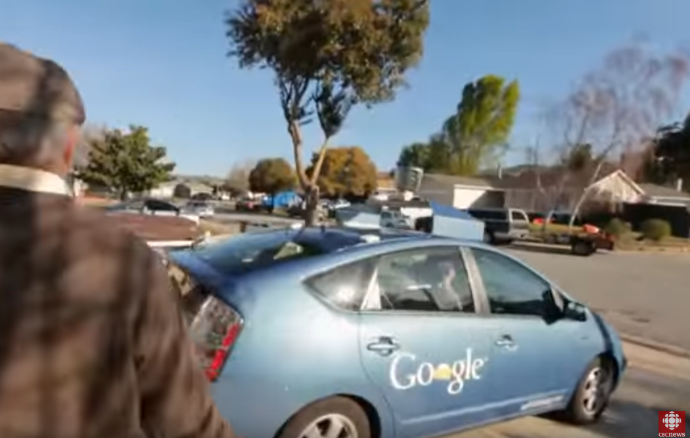
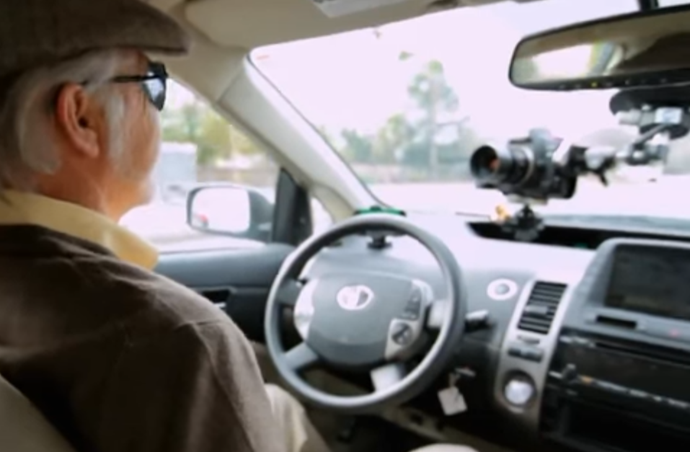
An Introduction
Notes:
https://www.youtube.com/watch?v=OXRQ7SMn0wI
Note that as amazing as this is, this is “old” news already - this video is from Sep ‘14 (almost three years ago)

Slide 5
What is an AV? (…it depends…)

Slide 6
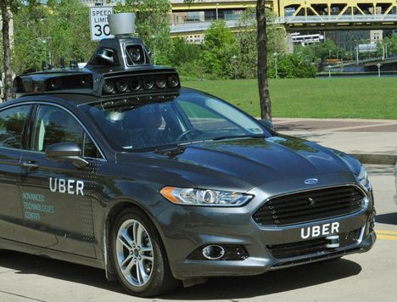
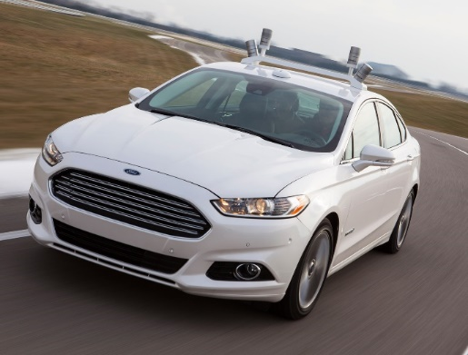
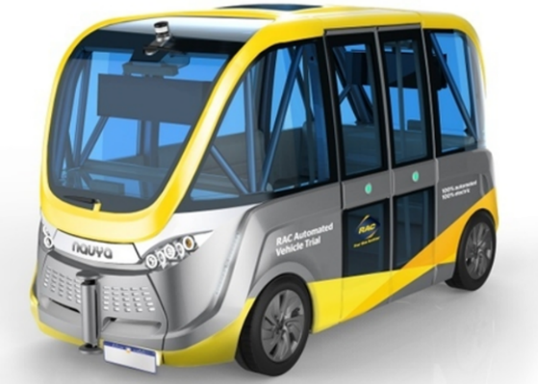
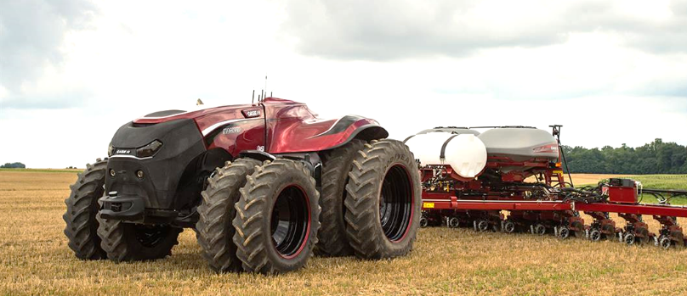
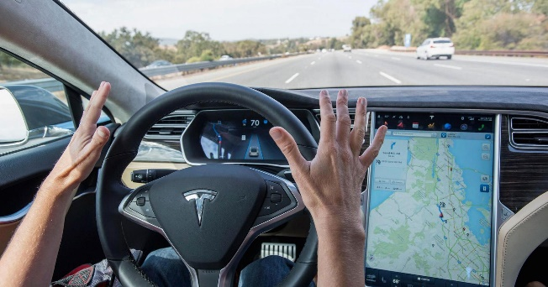
AVs Take Many Forms
P.D.D.
FORD
UBER
NAVYA
CASE IH
GM
TESLA
GOOGLE

Slide 7
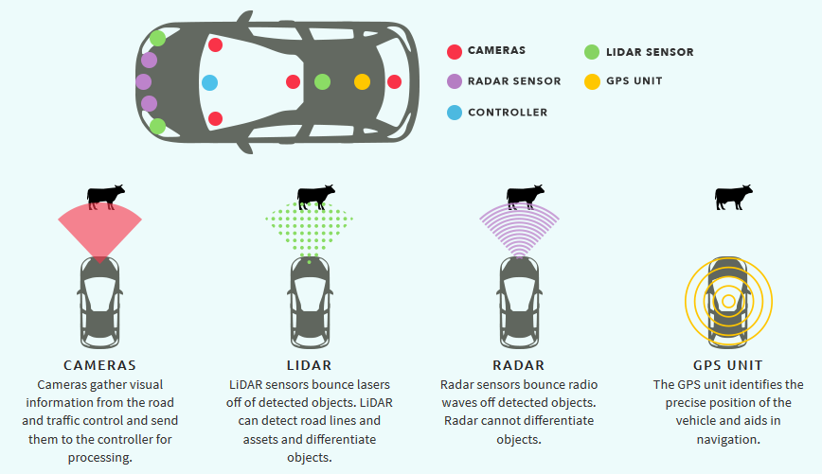
How AVs Operate
Notes:
And…
Gyro sensors, accelerometer, etc.
Hardware and software processing
Connectivity (WiFi, BlueTooth, 4G/5G, DSRC)
High-resolution basemap

Slide 8
How They See…

Slide 9
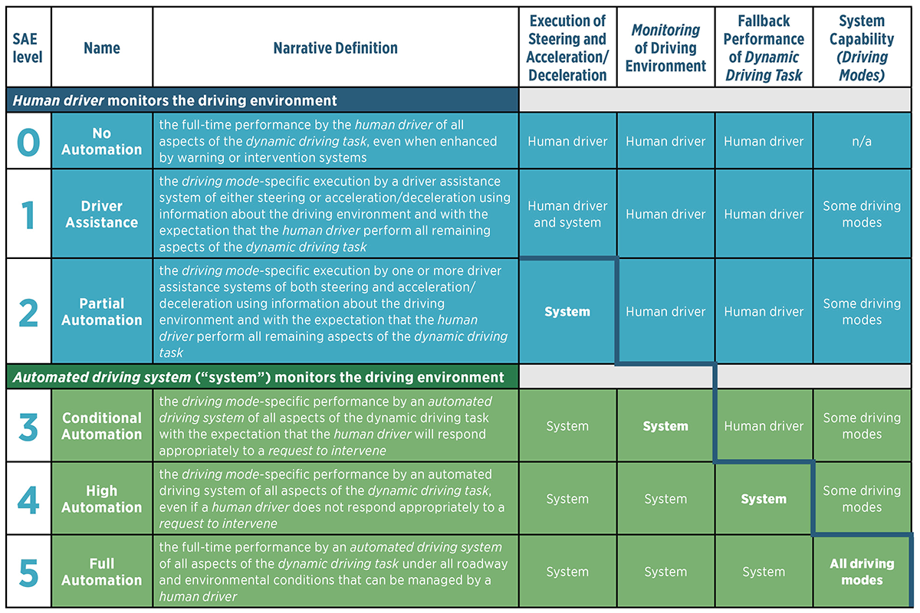
SAE Levels of Automation

Slide 10
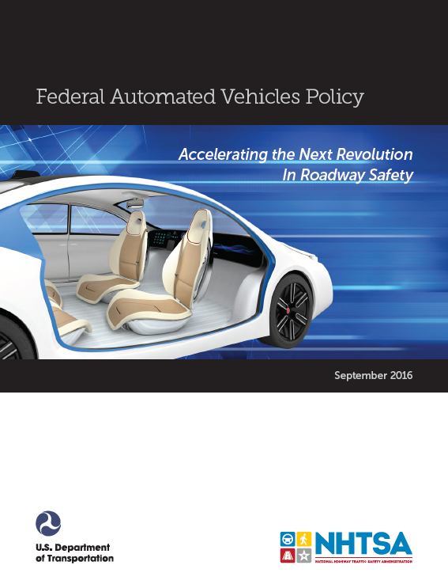
Federal AV Policy
Released September 20, 2016
Guidelines, not regulations
Proposes a 15-point safety assessment
Model State Policy

Slide 11
(An) AV Timeline
2015
driver assistance common
2020
limited / conditional AVs widely available to consumers
2025
autonomous shared mobility fleets
some partial automation available to consumers
2030
2035
2040
high automation required in all new vehicles
human operation is the exception in many places
transition to driverless largely complete
fleet turnover continues…
2100

Slide 12
R&D and the Wisconsin AV Proving Grounds

Slide 13
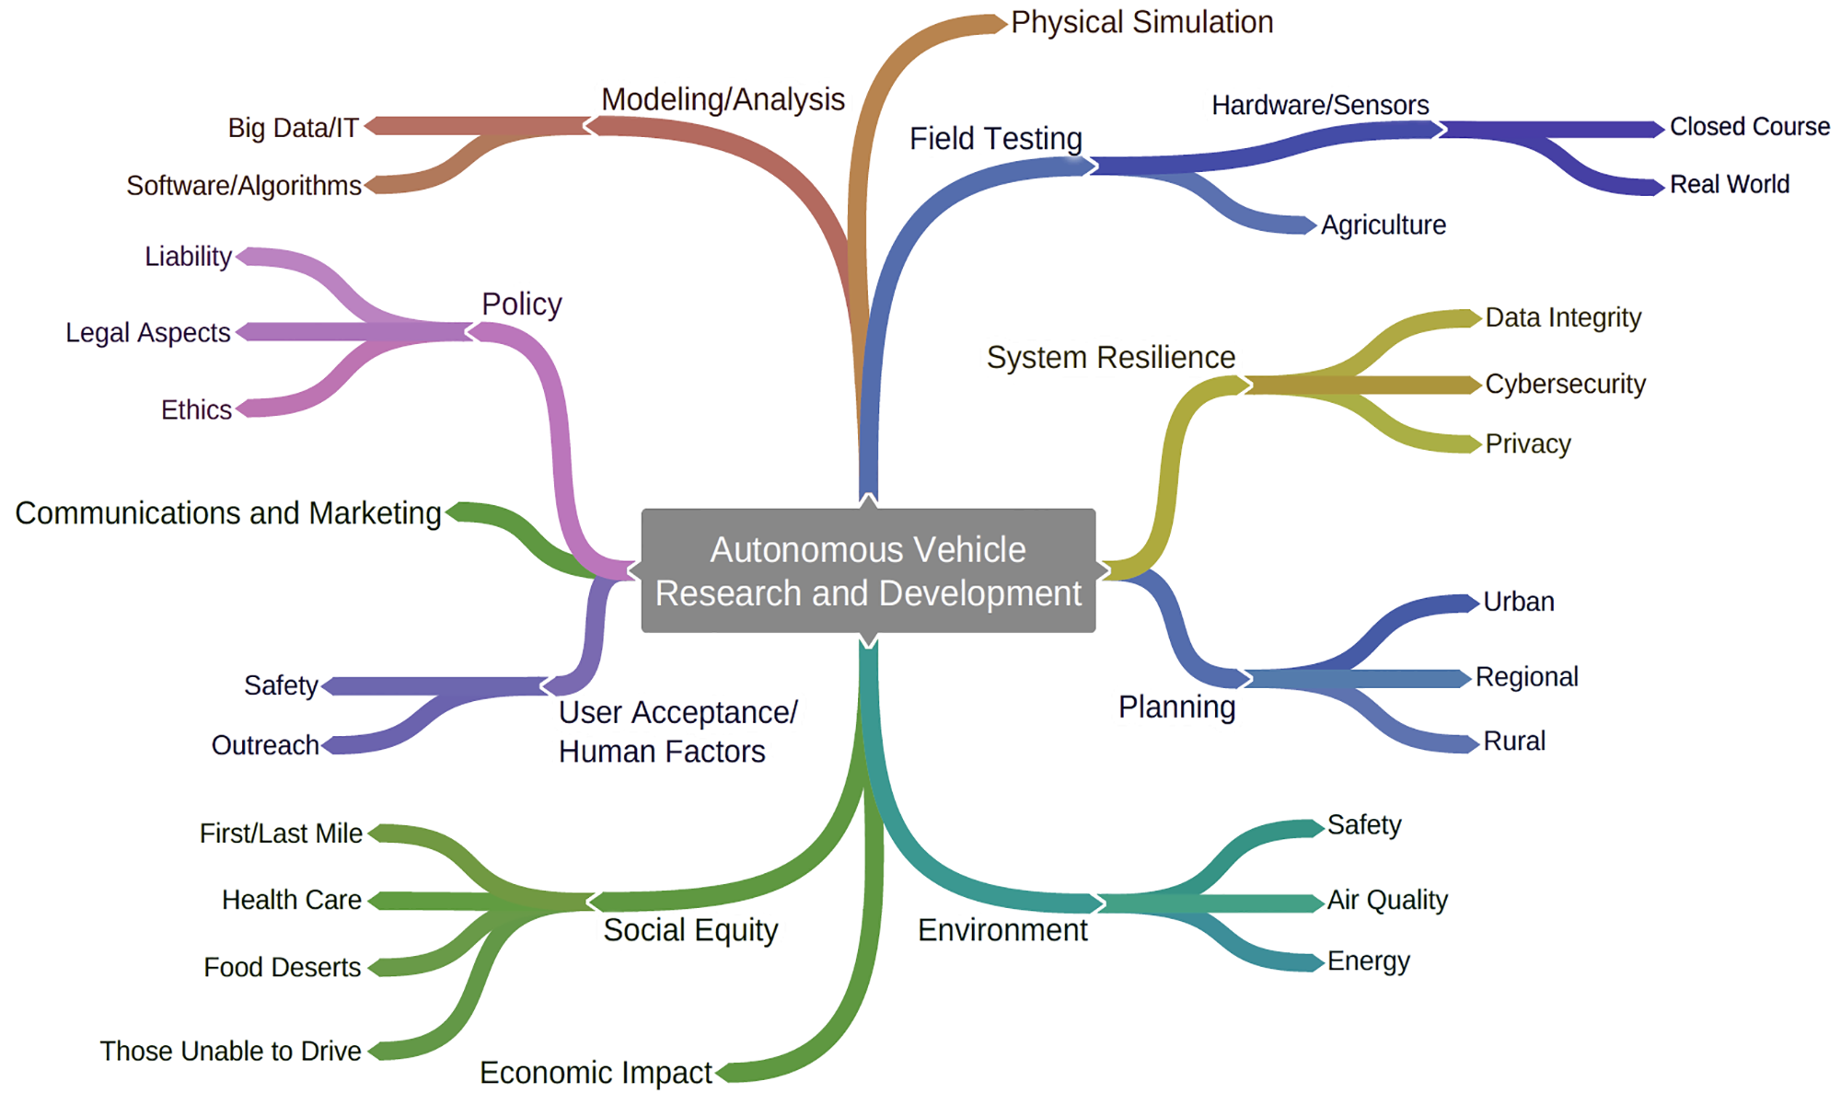
AV Issues are Complex

Slide 14
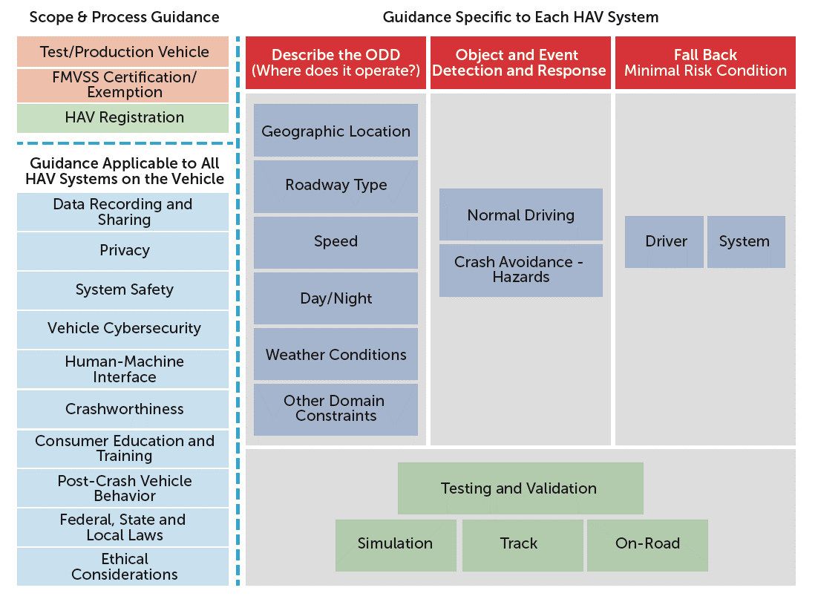

Slide 15
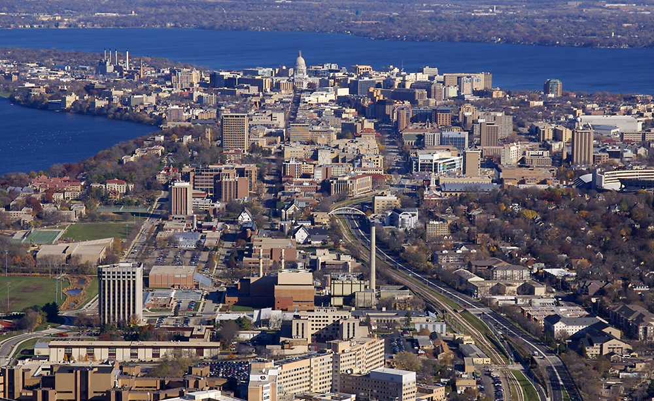
Our Regional Position
Great Lakes Megaregion
Great Lakes 60M pop.
City of Madison

Slide 16
Smart Cities Context

Slide 17
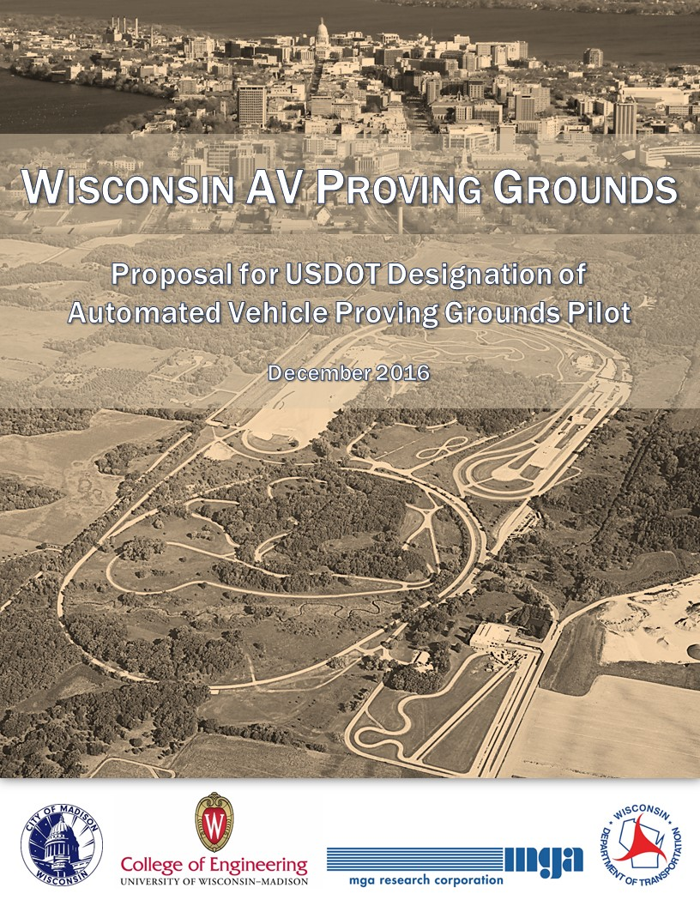
USDOT Solicitation
December 2016
Peer network
No funding

Slide 18
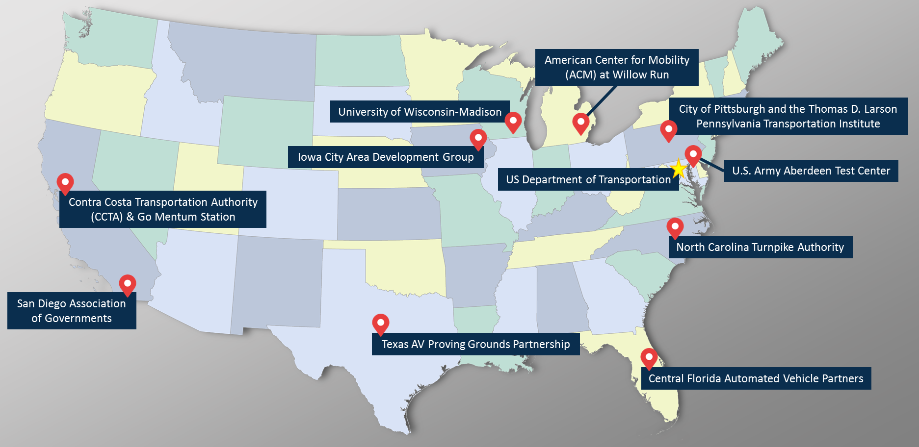
Ten Designated AV Proving Grounds

Slide 19
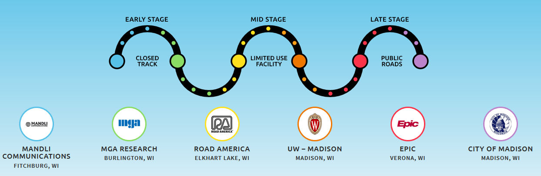
Wisconsin Partners

Slide 20
Mandli / Roadview
LiDAR and Basemapping

Slide 21
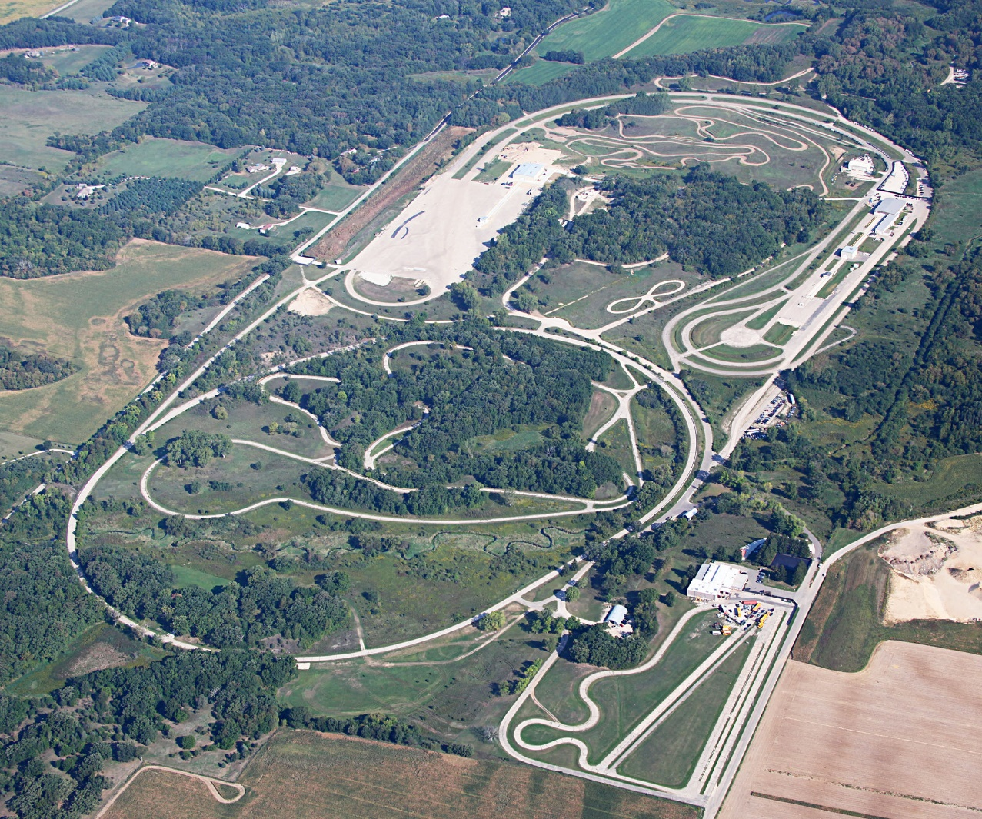
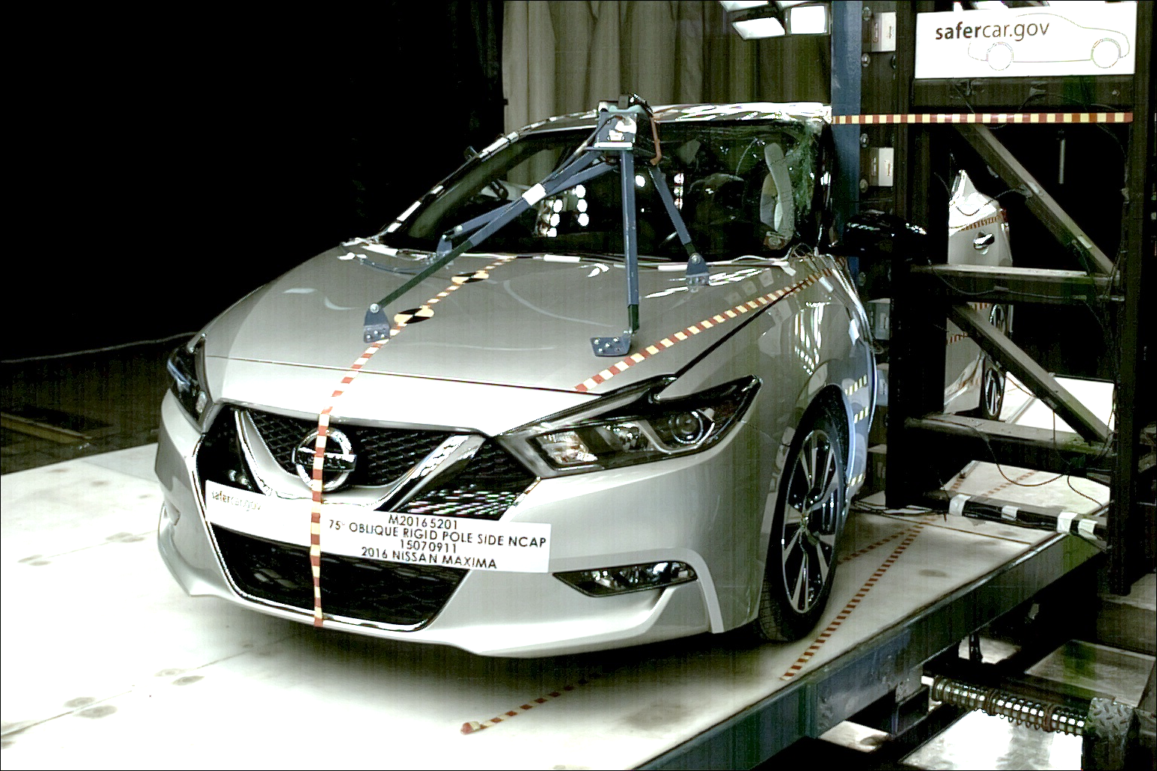
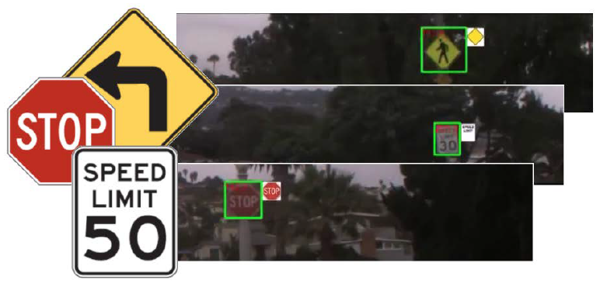
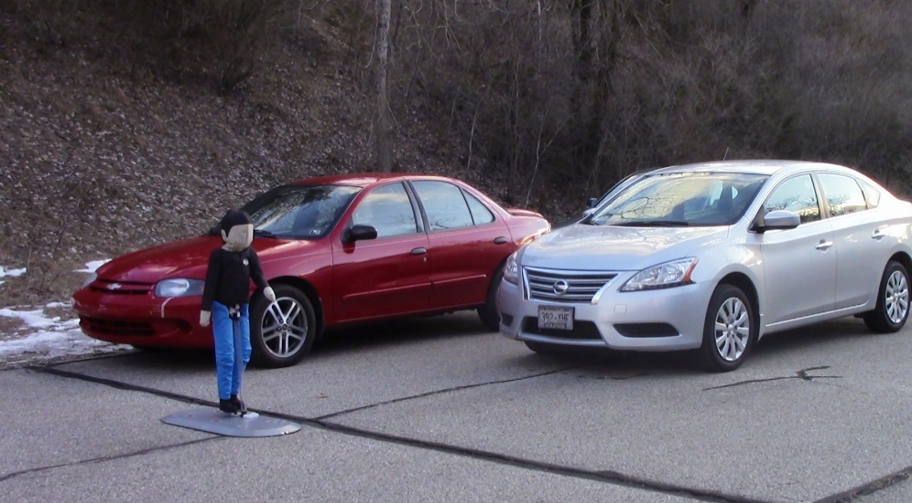
MGA Research, Burlington
400 acres, private and secure

Slide 22
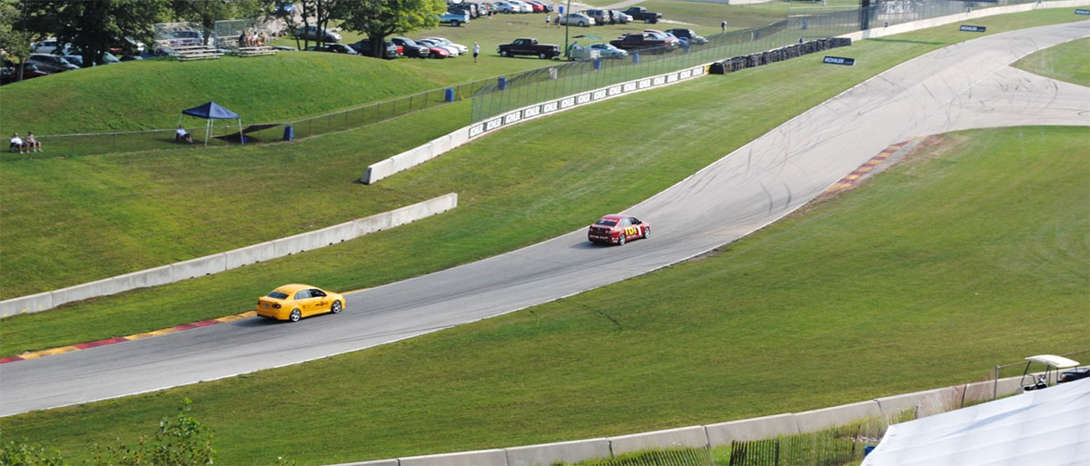
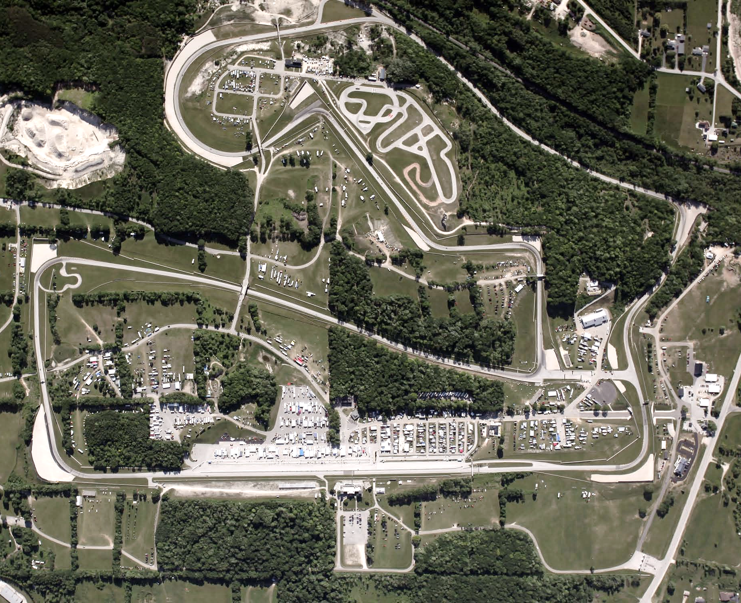
Road America, Elkhart Lake
Road track: 4.05-mile length, 30-foot width
1-mile combo paved-dirt track
12+ miles off-road
10+ miles access roads
Major race events and media presence

Slide 23
R&D Focus Areas
Technology: test environments, vehicles, sensors, hardware, software
Infrastructure: connected data, basemapping, exchange protocols, interactions
Governance: policy, regulations, standards, acceptance, certification
Governance
Technology
Infrastructure

Slide 24
Regulation and Policy
Modeling &
Analysis
Physical Simulation
Policy Evolution
Liability & Insurance
Privacy & Security
Field Evaluation
Legal Environ.
Regulatory & Enforcement
Federal, State, and Municipal Roles

Slide 25
Trends, Challenges, and Implications

Slide 26
Traffic Fatalities Rising
Nationally, two-year increase
Approaching 40,000 deaths
Wisconsin:
Pedestrian deaths now up to 15% of all traffic deaths

Slide 27
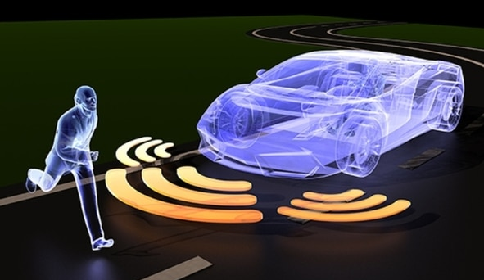

Slide 28
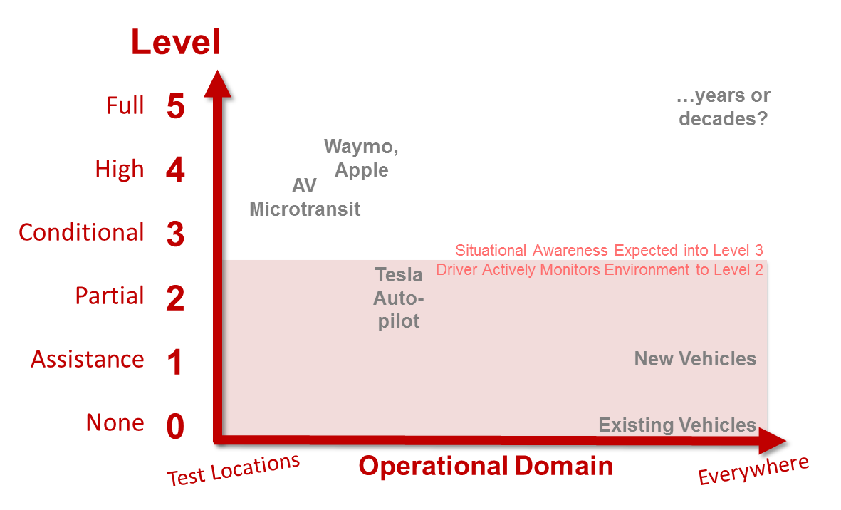
The Messy Middle

Slide 29
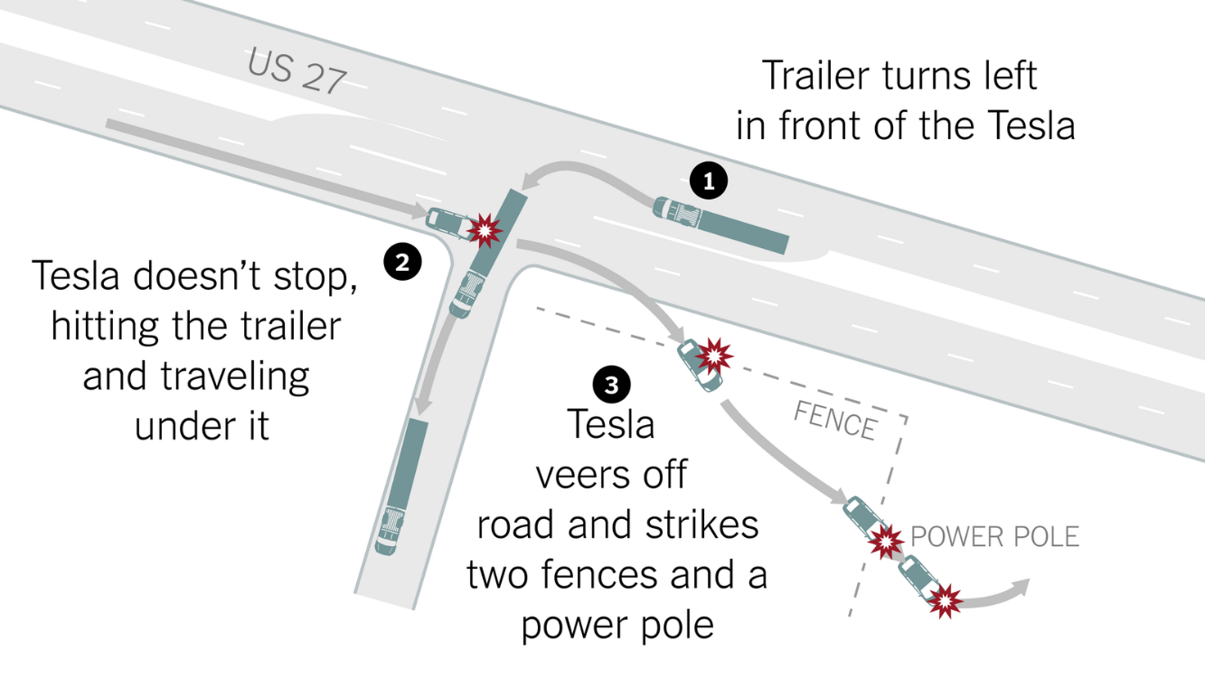
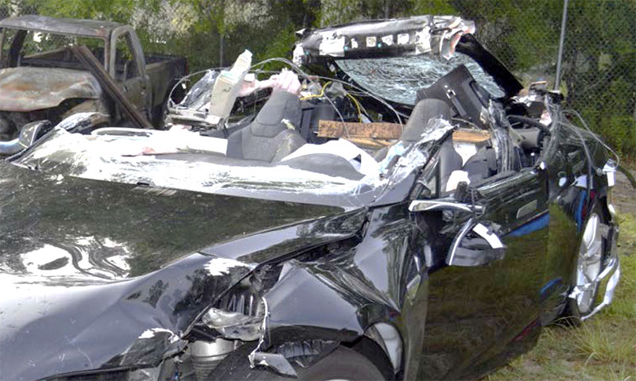
Partial Automation
Tesla Florida May 2016

Slide 30
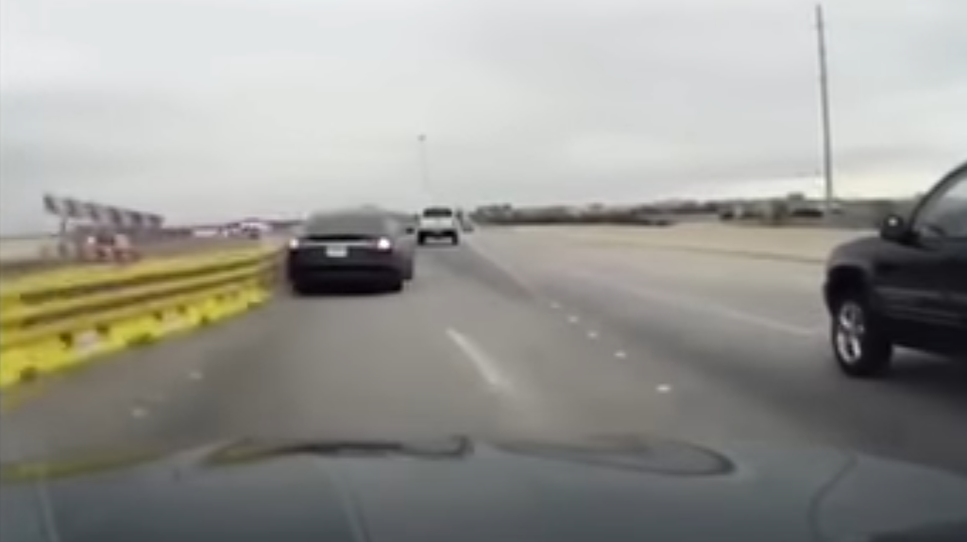
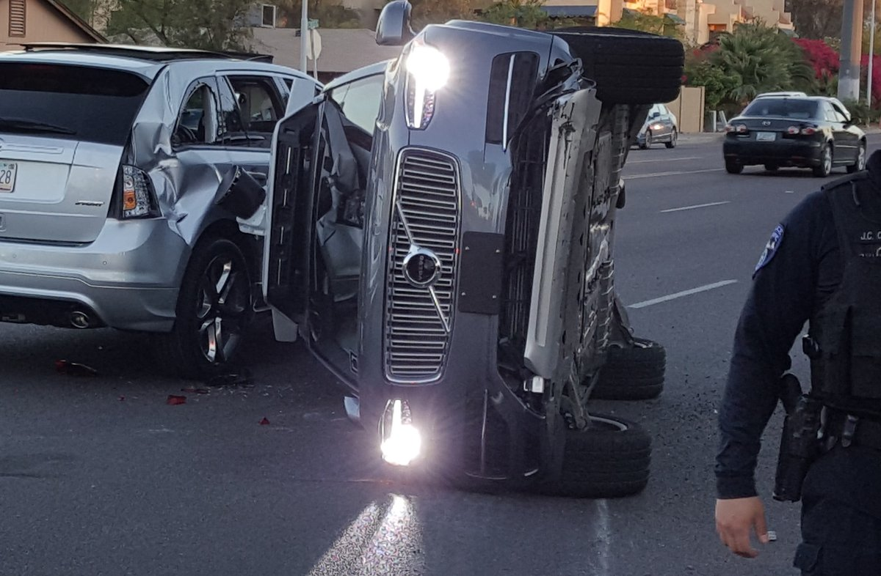
Partial Automation
Tesla March 2017
Uber March 2017

Slide 31
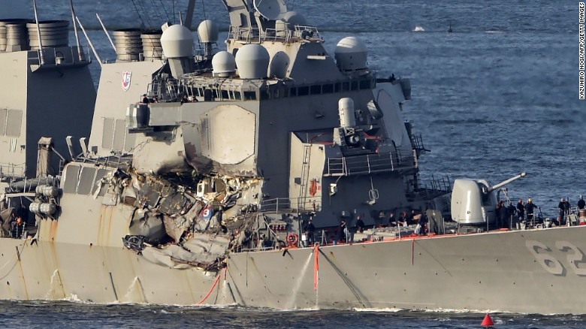
Autopilot and the Re-engagement Challenge
June 2017
Notes:
June 17, 2017. Destroyer Fitzgerald and ACX Crystal.

Slide 32
Trends and Outcomes
Safety
Vehicle Miles Traveled (VMT)
Sprawl
Parking
Air Quality
Public Health
Equity
Accessibility
Electrification
Automation
Ownership and Shared Mobility

Slide 33
Changing Auto Ownership

Slide 34
Liability and Insurance
Very Active Area of Work
Data, and Access, Including Near Misses
Certified Operating Conditions
Simulation Environments
“the automated driving industry will likely bear a bigger slice of a smaller pie of total crash costs“ - Bryant Walker Smith

Slide 35
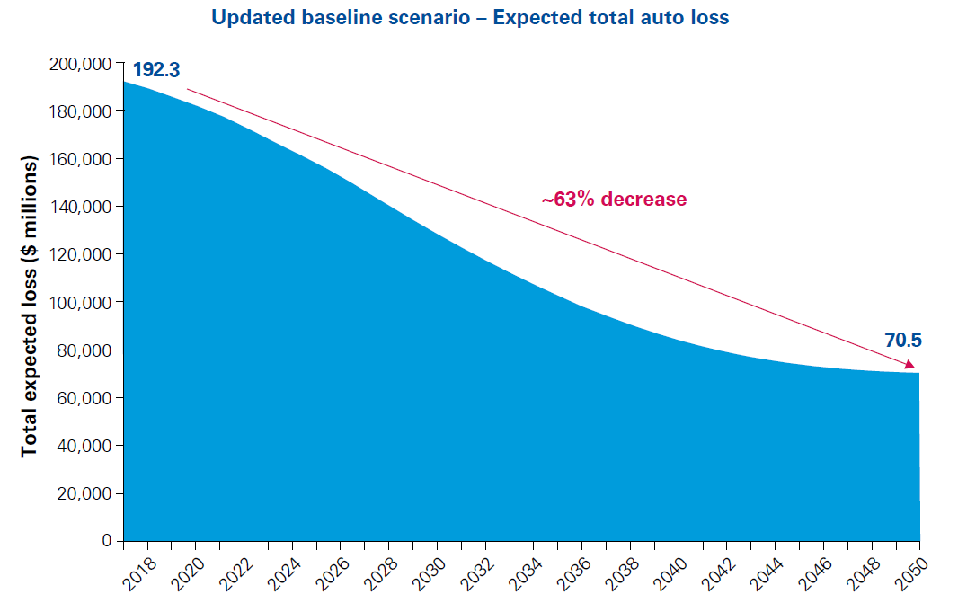
KPMG Report, June 2017

Slide 36
Thank You
Peter Rafferty
608-890-1218 prafferty@wisc.edu

